Slide 1
Class 6
International Transactions and the Trade Balance by
Alan V. Deardorff
University of Michigan
2020
PubPol/Econ 541

Slide 2
Announcements
Quiz 2
  Missing figure (fixed for most of you)
  My mistake in question 4 (should have been “small” country) (gave credit to all)
Papers
  Group assignments in Canvas: Files / Paper Assignments
  Assignments are on website under Paper Assignments
  First paper is due Thu, Oct 8, 8:30 AM on Canvas
  Groups are set in Canvas; turn in once per group
Questions
  At a request from one of you, I now put answer to the class discussion questions in Canvas, after the class where they may have been used.

Slide 3
Announcements
Quiz 2, Question 9
Increased revenue of suppliers is e+f+b
Almost all answered only e
P
S
P_{W} +t=P₁
e
f
g
h
P_{W}
a
b
c
d
D
Q^{S}₀
Q^{S}₁
Q^{D}₁
Q^{D}₀
Q

Slide 4
Outline
A Bit of Macroeconomics
The Balance of Payments Accounts
Surpluses and Deficits
They Add to Zero
What a Deficit Means
The Assumption of Balanced Trade

Slide 5
A Bit of Macroeconomics
From KOM:
  Y = C + I + G + (X – M)
  Where
    Y = GDP = Gross Domestic Product
    C = Consumption
    I = Investment
    G = Government purchases
    X = Exports
    M = Imports

Slide 6
A Bit of Macroeconomics
GDP measures
  The economy’s output of goods and services
  Essentially the same as National Income
  GDP is positively related to, but not the same as
    Employment
    Welfare
    Happiness
  And there are problems even with measuring output. E.g., it misses all that we produce in our homes

Slide 7
Pause for Discussion

Slide 8
  Questions
What’s the difference between GNP and GDP?
Why does GNP (or GDP) only include consumption of final goods, not firms’ purchases of intermediate inputs?
Why are imports subtracted from C+I+G+X–M in calculating GDP? Is it because imports cause unemployment?

Slide 9
The Balance of Payments Accounts
Recording International Transactions
  Credits versus debits
    Credits correspond to payments that would flow into the country
      Exports
      Borrowing from foreigners
      Collection of interest and dividends from foreigners
    Debits correspond to payments that would flow out of the country
      Imports, etc.

Slide 10
The Balance of Payments Accounts
Recording International Transactions
  Current versus Financial Accounts
    Financial account is (only) changes in holding of assets by one country in another
    Current account is everything else
      Trade (both goods and services)
      Income payments (wages, interest, & dividends)
      Transfers (Gifts, remittances, and foreign aid)

Slide 11
The Balance of Payments Accounts
Accounts |  |  |  | Credits | Debits
 | Current Account
 |  | Exports |  | +
 |  |  | Goods
 |  |  | Services (including investment income rcvd)
 |  | Imports |  |  | –
 |  |  | Goods
 |  |  | Services (including investment income paid)
 |  | Transfers |  | + (in) | – (out)
 | Financial Account
 |  | Change in US assets held abroad |  |  | –
 |  | Change in foreign holdings of assets in US |  | +
Balance on Current Account: Credits minus Debits
Balance on Financial Account: Credits minus Debits

Slide 12
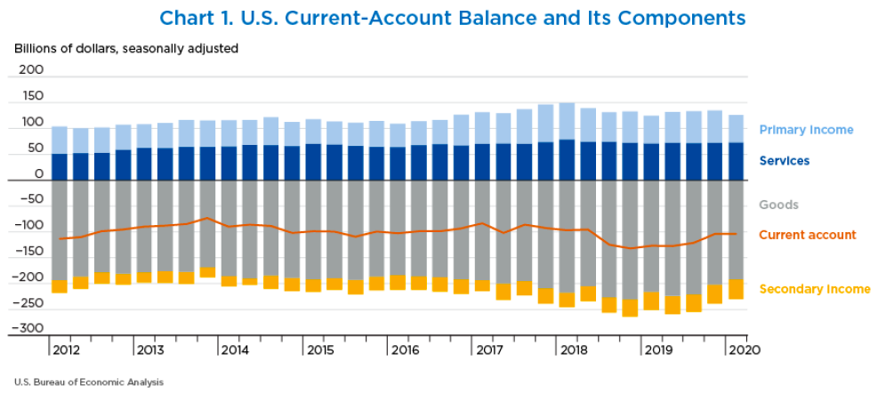
Notes:
Garber, Molly, “U.S. International Transactions: First Quarter 2020,” Survey of Current Business, 100(7), July 2020.
https://apps.bea.gov/scb/2020/07-july/pdf/0720-quarterly-international-transactions.pdf

Slide 13
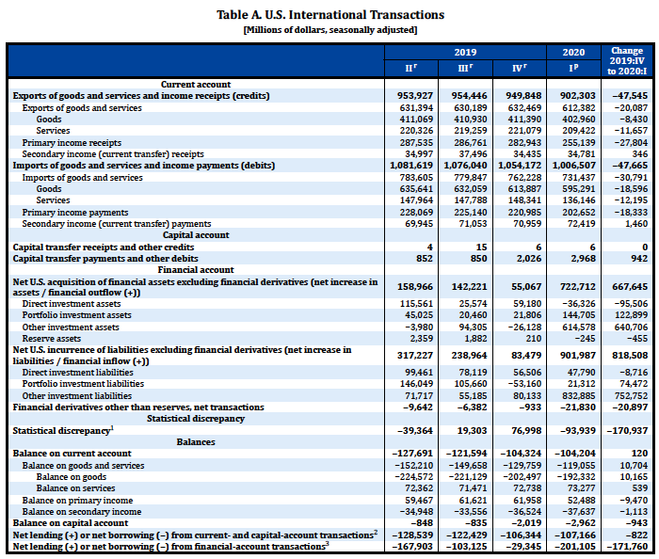
Note that Bal on CA is –127,691
≅ 953.927 – 1,081,619
( = –127,692 )
These are all debits and therefore negative.
Ignore this.
It’s small.
These are also debits and therefore negative.
Really, errors and omissions
Notes:
Garber, Molly, “U.S. International Transactions: First Quarter 2020,” Survey of Current Business, 100(7), July 2020.
https://apps.bea.gov/scb/2020/07-july/pdf/0720-quarterly-international-transactions.pdf

Slide 14
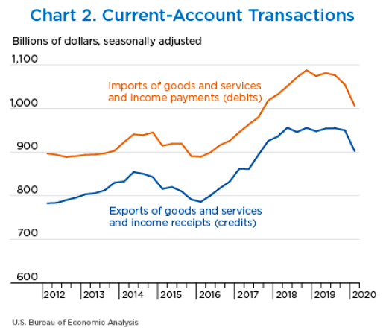
Trade War
Covid-19
Notes:
Garber, Molly, “U.S. International Transactions: First Quarter 2020,” Survey of Current Business, 100(7), July 2020.
https://apps.bea.gov/scb/2020/07-july/pdf/0720-quarterly-international-transactions.pdf

Slide 15
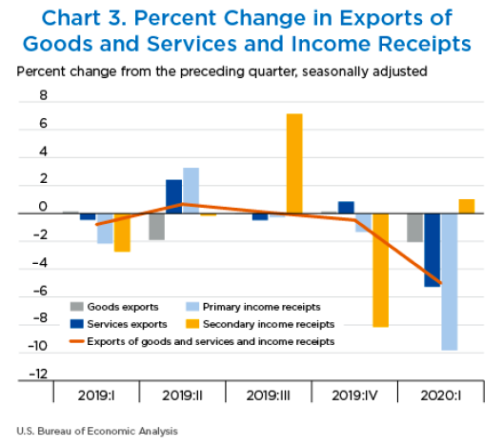
Notes:
Garber, Molly, “U.S. International Transactions: First Quarter 2020,” Survey of Current Business, 100(7), July 2020.
https://apps.bea.gov/scb/2020/07-july/pdf/0720-quarterly-international-transactions.pdf

Slide 16
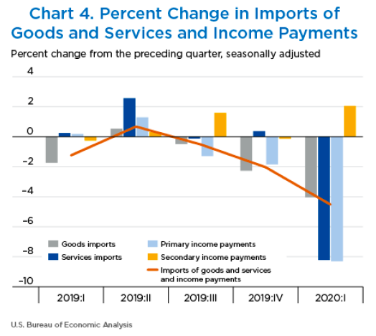
Notes:
Garber, Molly, “U.S. International Transactions: First Quarter 2020,” Survey of Current Business, 100(7), July 2020.
https://apps.bea.gov/scb/2020/07-july/pdf/0720-quarterly-international-transactions.pdf

Slide 17
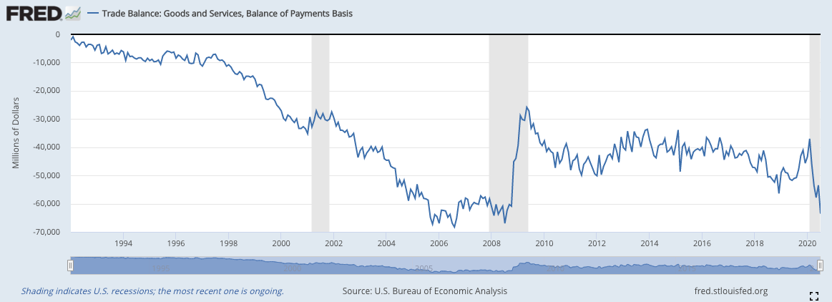
Note the zero. This whole thing is negative – a deficit!
Notes:
FRED,
https://fred.stlouisfed.org/series/BOPGSTB

Slide 18
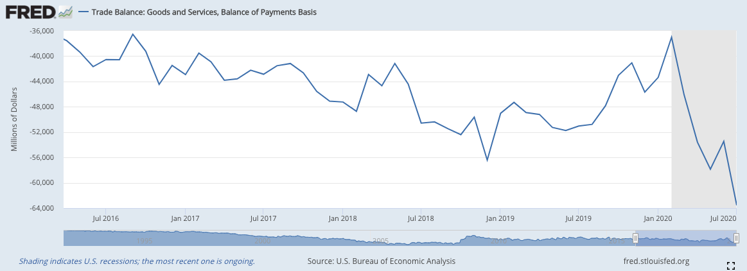
Trump
Deficit grew larger...
…then smaller…
…then larger
Notes:
FRED,
https://fred.stlouisfed.org/series/BOPGSTB

Slide 19
The US Trade Deficit
Grew from about $2 billion in 1992 to almost $70 billion in 2006
Shrank in the recessions of 2001 & 2008, but not 2020
Grew for Trump’s fist two years, then fell until 2020
Has grown to almost the 2006 level in 2020

Slide 20
Pause for Discussion

Slide 21
  Questions
What distinguishes credits and debits in the balance of payments?
For which categories of transactions did credits exceed debits for the United States in 2009 (the year reported in KOM)? Trade in goods? Trade in services? Primary income? Secondary income? Changes in asset holdings?
What mostly happened to current account transactions in Q1 of 2020 compared to Q1 of 2019?

Slide 22
Surpluses and Deficits
For any subset of transactions
  “Surplus” is credits > debits
  “Deficit” is debits > credits
Common “balances”:
  Balance of Merchandise Trade (i.e., goods)
  Balance on Goods and Services
  Balance on Current Account
  Balance on Financial Account
    =Capital inflows minus capital outflows

Slide 23
They Add to Zero
If all transaction were captures perfectly, then all would add to zero
  ∑ credits = ∑ debits
Thus
  Balance on Current Account
  +
  Balance on Financial Account
  = 0
(If they don’t, there must be errors, hence “statistical discrepancy”)

Slide 24
They Add to Zero
Why?
  Every actual transaction has two parts, and these cancel each other
    Example: I buy a book for $10 from the UK
      That’s a US debit 0f $10
      If the seller keeps the $10 cash, it’s an increase in that foreigner’s holdings of US assets (the $10 bill), a US credit
      They may do many other things with the $10, but each of them would result in either a $10 US credit or reversing a $10 US debit

Slide 25
They Add to Zero
Implication
  A trade (or current account deficit) must be accompanied by
    Financial account surplus
    Thus net capital inflow
How does it happen?
  Credits correspond to supply of foreign exchange
  Debits correspond to demand for foreign exchange
  So exchange-market equilibrium
    Implies supply = demand
    Implies credits = debits

Slide 26
What a Deficit Means
Recall (from macroeconomics) the definition of GDP
  GDP = Y = C + I + G + (X – M)
    (C + I + G) equals expenditure, E
    (X–M) equals trade surplus
  So:
  X – M = Y – E
  Trade surplus equals
  Income minus expenditure

Slide 27
What a Deficit Means
Interpretations of a trade deficit
    (as the US has had for decades)
  We are spending more than our income
  We are consuming more goods that we are producing
  We are borrowing from (or selling assets to) foreigners

Slide 28
What a Deficit Means
Another Interpretation
  With T = net taxes, then Y–T is “disposable income”
  Rearrange: Y = C + I + G + (X – M)
  (Y – T – C) + (T – G) = (X – M)
  Private savings + Government saving = (X – M)
  Thus
  X – M = S – I

Slide 29
What a Deficit Does Not Mean
That foreign trade barriers are hurting our exports
That other countries are engaged in unfair trade
That our firms are not competitive
That we are losing jobs to other countries
That we need to restrict trade
(But note that many disagree, including Trump and two of the optional readings: Scott and Mokhiber, and Buffet)

Slide 30
Pause for Discussion

Slide 31
  Questions
Why must credits and debits exactly offset if measured accurately?
KOM defines a country’s current account surplus as its exports minus its imports. Why is this also said to equal “net foreign investment”?
What are, and what are not, the implications of a trade deficit? Jobs? Debt? Trade barriers? Competitiveness?

Slide 32
What a Deficit Means
Is a trade (or current account) deficit good or bad?
  It depends

Slide 33
Pause for Discussion

Slide 34
  Questions from Obstfeld
Is a country with a trade deficit losing from trade?
What determines a country’s bilateral deficits and surpluses?
Why does the fact that the US was at full employment matter for the discussion in Obstfeld?

Slide 35
Balanced Trade
In this course we will assume either
  Trade is balanced, or
  The trade imbalance does not change
Why?
  Because the trade imbalance depends
    On macroeconomic factors, such as monetary and fiscal policies
    Not on the trade policies will are studying

